Slide 1
Fine Arts Portfolio
(ART SECTION)

Slide 2
PORTFOLIO Theme
Grade Level: Kindergarten
Overarching theme: Fairytales/ Jack and the Bean Stalk
Subject focus for Art section: Mathematics

Slide 3
Kindergarten Mathematics TEKS
(2) Number and operations. The student applies mathematical process standards to understand how to represent and compare whole numbers, the relative position and magnitude of whole numbers, and relationships within the numeration system. The student is expected to:
(A) count forward and backward to at least 20 with and without objects;
(B) read, write, and represent whole numbers from 0 to at least 20 with and without objects or pictures;
(C) count a set of objects up to at least 20 and demonstrate that the last number said tells the number of objects in the set regardless of their arrangement or order;

Slide 4
Kindergarten art tekS
(2) Creative expression. The student communicates ideas through original artworks using a variety of media with appropriate skills. The student expresses thoughts and ideas creatively while challenging the imagination, fostering reflective thinking, and developing disciplined effort and progressive problem-solving skills. The student is expected to:
(A) create artworks using a variety of lines, shapes, colors, textures, and forms;
(B) arrange components intuitively to create artworks; and
(C) use a variety of materials to develop manipulative skills while engaging in opportunities for exploration through drawing, painting, printmaking, constructing artworks, and sculpting, including modeled forms.

Slide 5
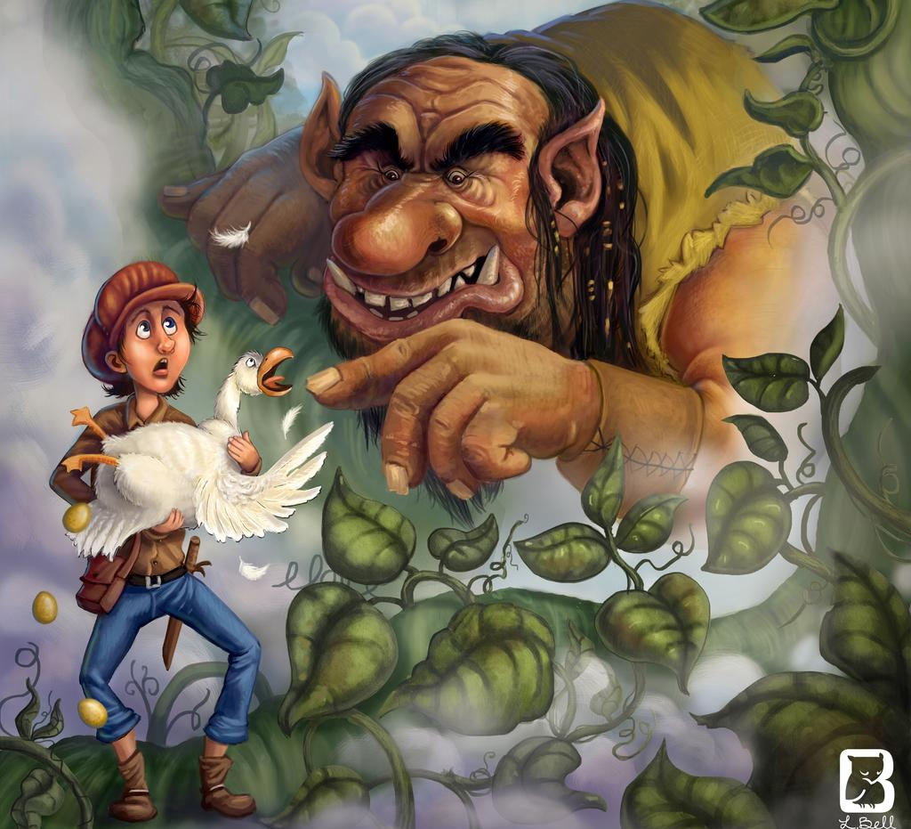
“Jack and the Beanstalk”
By Lindsey bell

Slide 6
One local Visiting artist
I would invite and contact Lindsey Bell by starting out by explaining that my classroom is Jack and the Bean Stalk themed and that some of her artwork would be perfect for some of the prepared lessons and would be interested in her doing a art lesson presentation with my students. This would relate to what is being taught because it allows for the students to establish and draw connections to the artwork being shown about Jack and the Bean Stalk and this allows for further connections in all over content areas such as their math lesson with the beans which also allows theme to venture into creative expression and establish a healthy imagination in the classroom.
Lindsey Bell/ Texas Residency and Denver Colorado Residency/ Email: Lindseyillustrations@gmail.com/ Phone Number: 303-501-5050
Lindsey Bell is a Children's book creator and aspiring artist who works as a freelance illustrator and teacher. She received her BFA in illustration from Rocky Mountain College of Art and Design and is currently residing in the suburbs of Denver Colorado. Her services and specialties are in children’s book illustration, cover illustrations, character design, editorial illustration and teaching.
I chose this artist because she is a children’s book illustrator and received her BFA in Illustration so I knew she was a certified source for classroom artwork and would be beneficial to tie into the lessons being taught.
The teaching objective that will be addressed will be how to create artworks using a variety of lines, shapes, colors, textures, and forms.

Slide 7
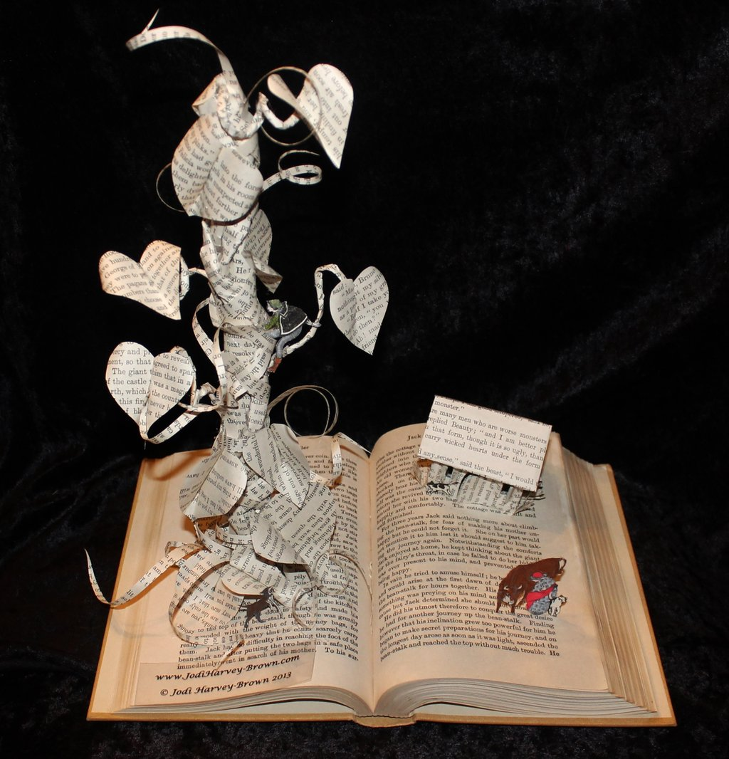
“Jack and the beanstalk BOOK SCULpture”
By JODI HARVEY

Slide 8
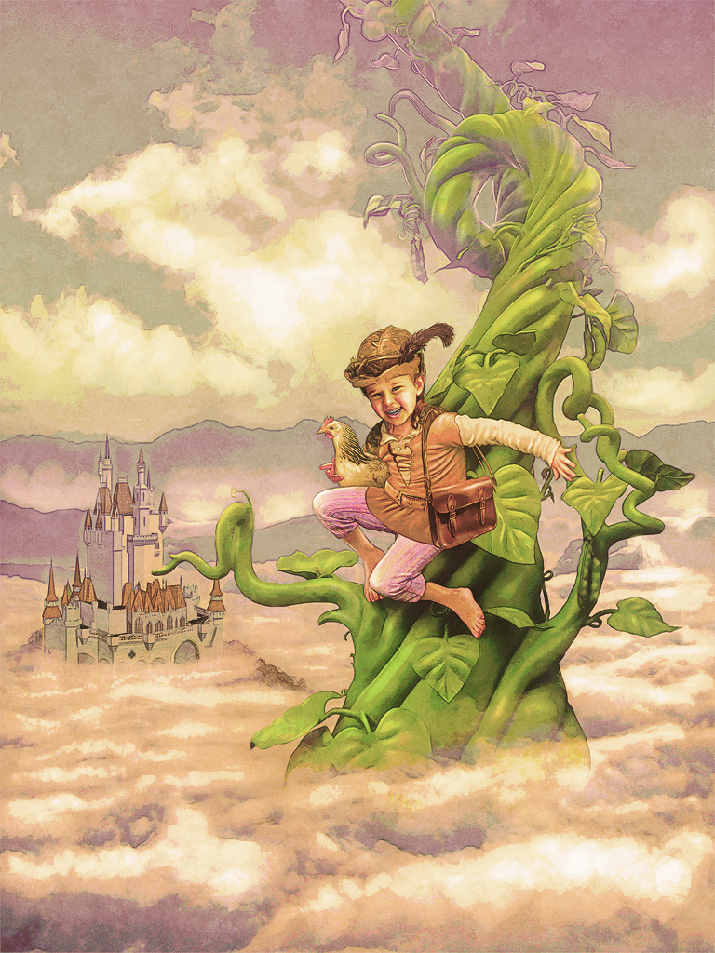
“JACK AND the beanstalk digital art”
BY: Deviant art

Slide 9
LESSON PLAn
3315 Lesson Cycle Template
Engagement/Connecting to Prior Knowledge | I will start off by asking my class to gather around into the classroom reading circle and reading a short version of Jack and the Bean Stalk to them to help introduce them to the theme of the classroom and allow for them to make connections to what we are doing later on with beans and even in other content areas in class. Then I will show the first painting to allow for the students to make meaningful connections and assumptions about the story and show them what our beanstalk for the class will generally look like to spark excitement into the students. Then the visiting artist will come in to present the artwork!
Teaching Point | “Today, I want to teach you how to count, write and represent numbers from 0 to 20.” We will be starting off with a hands-on jellybean counting game and then applying our counting skills to make a large beanstalk for the classroom art center by gluing whatever number of beans you draw to the bean stalk leaf.
Teach | Today we will be using the jellybean graphing worksheet to help us in learning how to count, write and represent numbers from 0 to 20. You will be given a cup or egg filled with different colored jelly beans and you will open them up and dump them out, feel free to eat one or two and then sort them onto the graph by how many colors of each you have and then at the bottom write the number of how many are in each color and then pick two different colors and add up their numbers to make a sum and write it on the back of the paper. Then wait for instructions. After you write on the back of your paper the number, I want you to switch your paper with a partner at your table and then have them put the proper amount of beans around the number and then check your partner to see if they got it right! Both partners raise your hand when you agree on being done and the teacher will come by and check off your work! Now that we have successfully completed the jellybean sorting game lets move this into a hands-on sculpture activity for the class. I want to show you an interesting sculpture that ours will start to resemble just so you can get an idea of the art that we are creating in the classroom. I will explain how different material can be used to allow for different dimensions and textures in the paintings. Then, I will show the Digital Artwork to allow for the students to see the different colors, shapes and lines used in the art which hey can utilize into making the classroom bean stalk.

Slide 10
LESSON Plan
Continued
Lesson Plan
Active Engagement | Now you give it a try... First, you will randomly draw a magic bean number Then, you will say it out loud. Five. Then, you will reach into the magic bean cup and count out five magic beans to glue onto your bean stalk leaf. One! Two! Three! Four! Five! Finally, you will glue each of the five beans onto my number leaf and the notify the teacher to bring you some art supplied to pick and chose from in the art center to decorate your leaf using varying lines, shapes, colors, textures and forms. When finished notify the teacher and I will come help you attach it onto the Bean Stalk in the classroom. Did you see how I broke apart the assignment into steps and double checked my work as I went and used different techniques from my neighbors. We all learn different through varying learning styles. Tell me about the steps you took to make your magic bean leaf!
Link/Check for understanding | “Today we learned how to count, write and represent numbers from 0 to 20 through using jellybean graphing and the counting Bean Stalk leaf project. Who can tell me something they learned or really enjoyed about todays lesson? Alright that wraps up our art and math lesson for today class Ill see you all tomorrow! Great job I loved our classroom participation skills today!

Slide 11
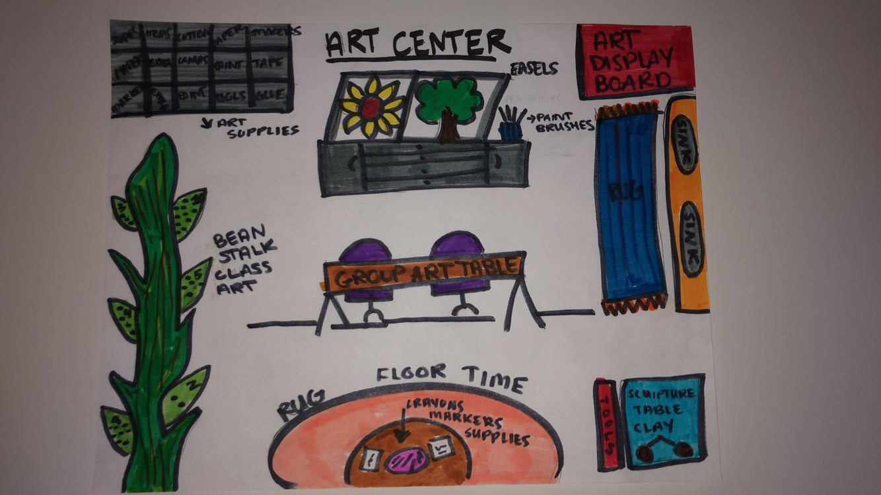
Art center floor plan

Slide 12
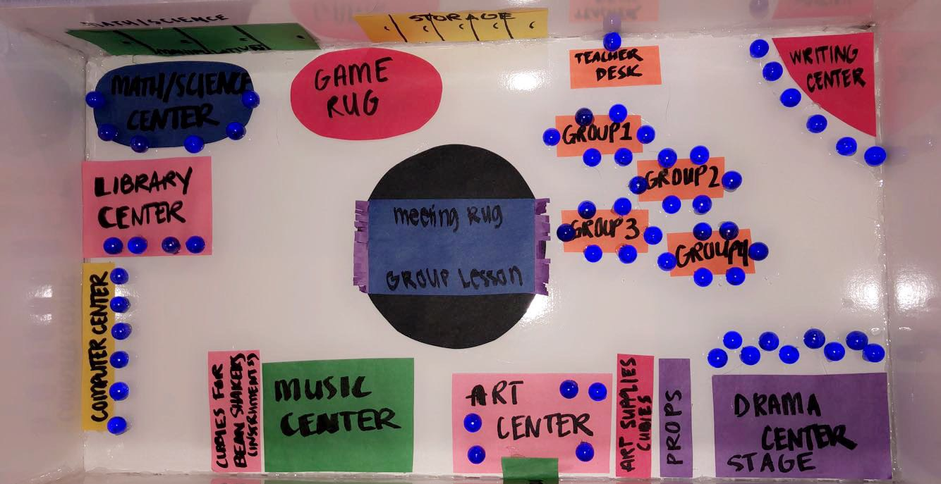
OVERALL CLASSROOM FLOOR PLAN

Slide 13
Art center floor plan DETAILS
Materials for Lesson and center: Jack in the Bean Stalk Book , Jellybean graphing worksheet, Jellybeans, Leaf cut outs, Decorative paper, Paint, Glue, Beans, cotton balls, tissue paper, etc.
The goal and purpose for the art center is to allow for the students to draw an understanding to the mathematics lesson and apply their creativity into being able to actively and successfully represent physically and verbally their numbers from 0 to 20.
The skills students will develop, and practice include writing, speaking and representing their numbers from 0 to 20 using beans as a counter in the classroom. Students will also practice active listening, engagement and participation in the classroom throughout all lessons being taught and practice appropriate and well managed independence through center time.
Students will actively listen before touching any materials and follow all instructions the teacher is giving to allow for maximum safety and reduction of chaos in the classroom. Through proper classroom management skills the students will fully participate in each lesson and activity to allow for maximum achievement and individual and group success through each skill, objective and lesson being taught by the instructor.

Slide 14
Assessment instrument
The purpose of these two assessments I found are to successfully benefit the students by assessing their knowledge, comprehension and understanding of the lesson on being able to count, write and represent their numbers of 0 to 20.
These assessments will gage their overall understanding on the topic at hand of counting 0 to 20 and number recognition to allow for the instructor to see where each student sits at with their individual counting skills.
The numeracy skills taps into their overall comprehension of knowing background on their numbers like what number comes before and after as well as which one is bigger and smaller etc.
The addition within 10 assessment will allow for the students to count and use their number from 0 to 10 to practice basic addition and number recognition within that number set and group.

Slide 15
